Slide 1
Probability Distribution (1)
Md. Ismail Hossain Riday

Slide 2
Variable
A quantity or characteristic that can take different values or vary in different situations.
For example: CGPA, Gender etc.

Slide 3
Random variable
A random variable is a variable
That can take different values (numerical)
Determined by the outcome of an experiment

Slide 4
Difference
The differences between variable and random variable are-
Random variable always takes numerical values
There is a probability associated with each possible values

Slide 5
Difference
The differences between variable and random variable are-
Random variable always takes numerical values
There is a probability associated with each possible values

Slide 6
Difference
The differences between variable and random variable are-
Random variable always takes numerical values
There is a probability associated with each possible values

Slide 7
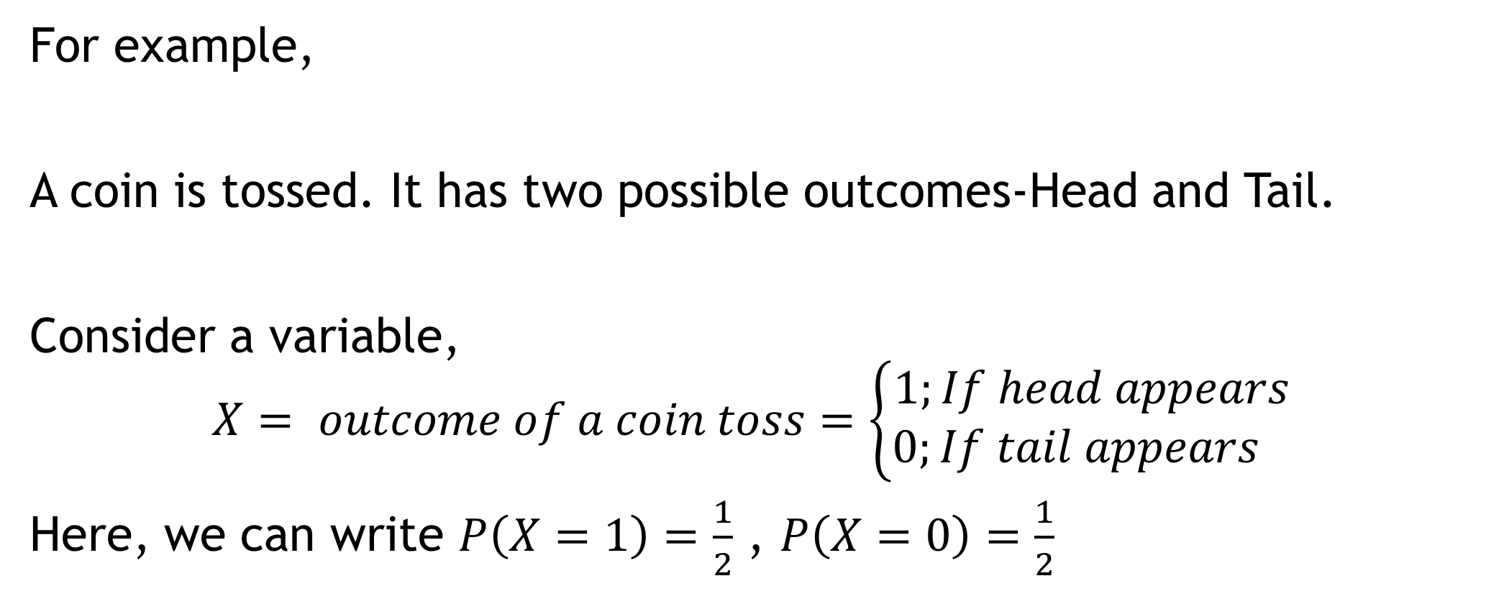
Example
For example,
A coin is tossed. It has two possible outcomes-Head and Tail.
Consider a variable,
$$X= outcome of a coin toss=\left\{\begin{aligned}1;If head appears \\ 0;If tail appears \end{aligned}\right.$$
Here, we can write $P\left(X=1\right)=\frac{1}{2}$ , $P\left(X=0\right)=\frac{1}{2}$

Slide 8

Types of Random Variable
$X=\left\{1, 2, 3, 4, 5, 6\right\}$
$X≥0$
Discrete
Random variable
Discrete
Continuous
Continuous

Slide 9
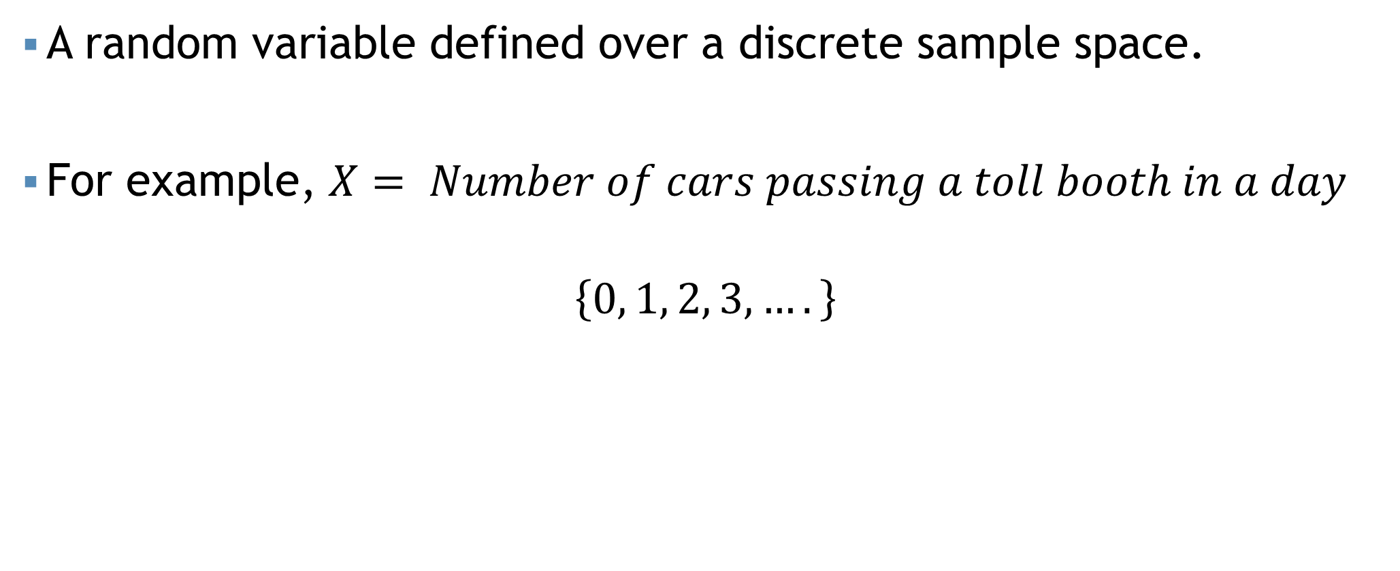
Discrete RV
A random variable defined over a discrete sample space.
For example, $X= Number of cars passing a toll booth in a day$
$$\left\{0, 1, 2, 3,….\right\}$$
Discrete random variable

Slide 10
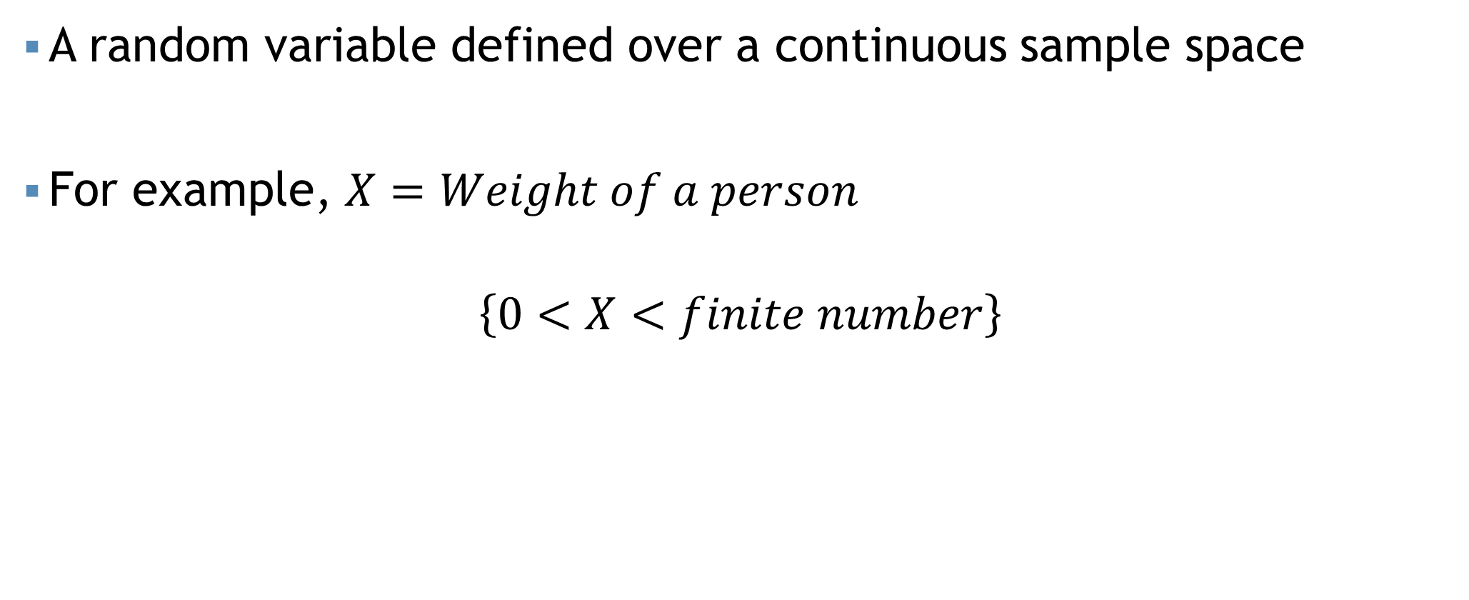
Continuous RV
A random variable defined over a continuous sample space
For example, $X=Weight of a person$
$$\left\{0<X<finite number\right\}$$
Continuous random variable

Slide 11
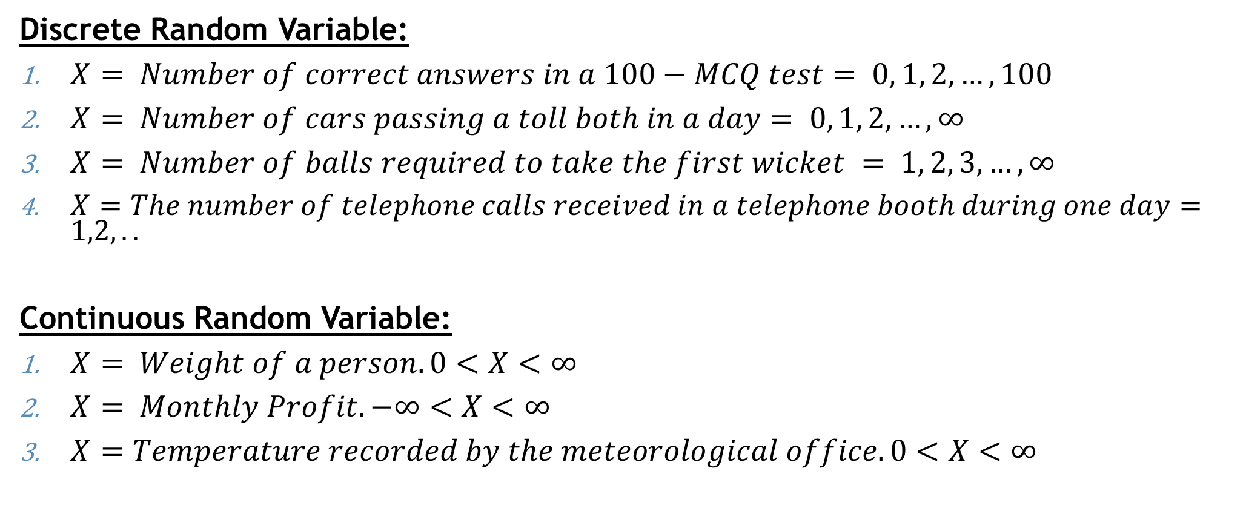
Examples
Discrete Random Variable:
$X= Number of correct answers in a 100−MCQ test= 0, 1, 2, …, 100$
$X= Number of cars passing a toll both in a day= 0, 1, 2, …, ∞$
$X= Number of balls required to take the first wicket = 1, 2, 3, …, ∞$
$X=The number of telephone calls received in a telephone booth during one day=1,2,..$
Continuous Random Variable:
$X= Weight of a person. 0<X<∞$
$X= Monthly Profit. −∞<X<∞$
$X=Temperature recorded by the meteorological office. 0<X<∞$

Slide 12
Probability Distribution
Distribution of the probabilities among the different values of a random variable.

Slide 13
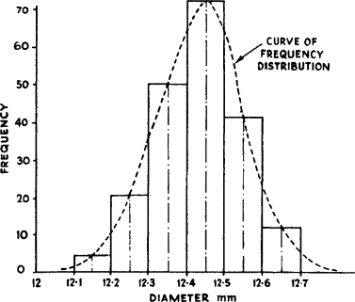
Probability Distribution
Probability Distribution

Slide 14
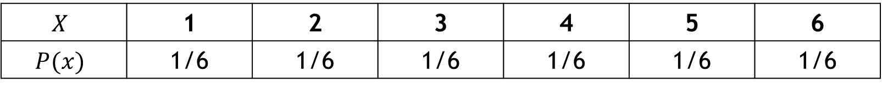
Probability Distribution
Distribution of the probabilities among the different values of a random variable.
For example, Here's an example probability distribution that results from the rolling of a single fair die.
$$X$$ | 1 | 2 | 3 | 4 | 5 | 6
$$P(x)$$ | 1/6 | 1/6 | 1/6 | 1/6 | 1/6 | 1/6

Slide 15
Types of PD
Probability Distribution
Discrete
Continuous

Slide 16

Discrete PD
Probability distribution of a discrete random variable
For example, $X= Number of cars passing a toll booth in a day$
$$\left\{0, 1, 2, 3,….\right\}$$
Discrete random variable
Discrete PD

Slide 17

Continuous PD
Probability distribution of a continuous random variable
For example, $X=Weight of a person$
$$\left\{0<X<finite number\right\}$$
Continuous random variable
Continuous PD

Slide 18
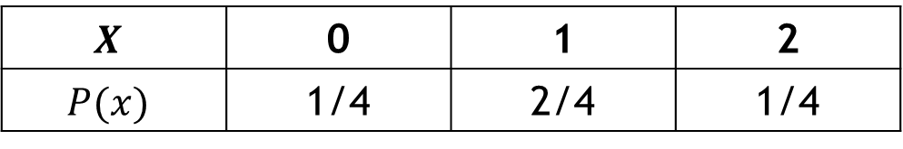

Example
Tossing a coin 2 times.
$X=Number of head appeared$
$S=\left\{HH,HT,TH,TT\right\}$
$$X$$ | 0 | 1 | 2
$$P(x)$$ | 1/4 | 2/4 | 1/4

Slide 19
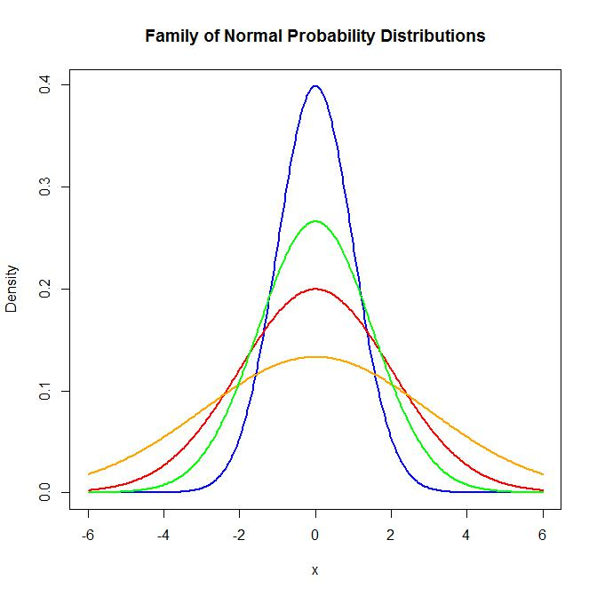
Example

Slide 20
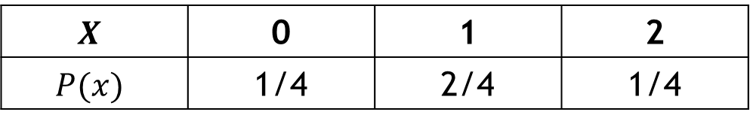
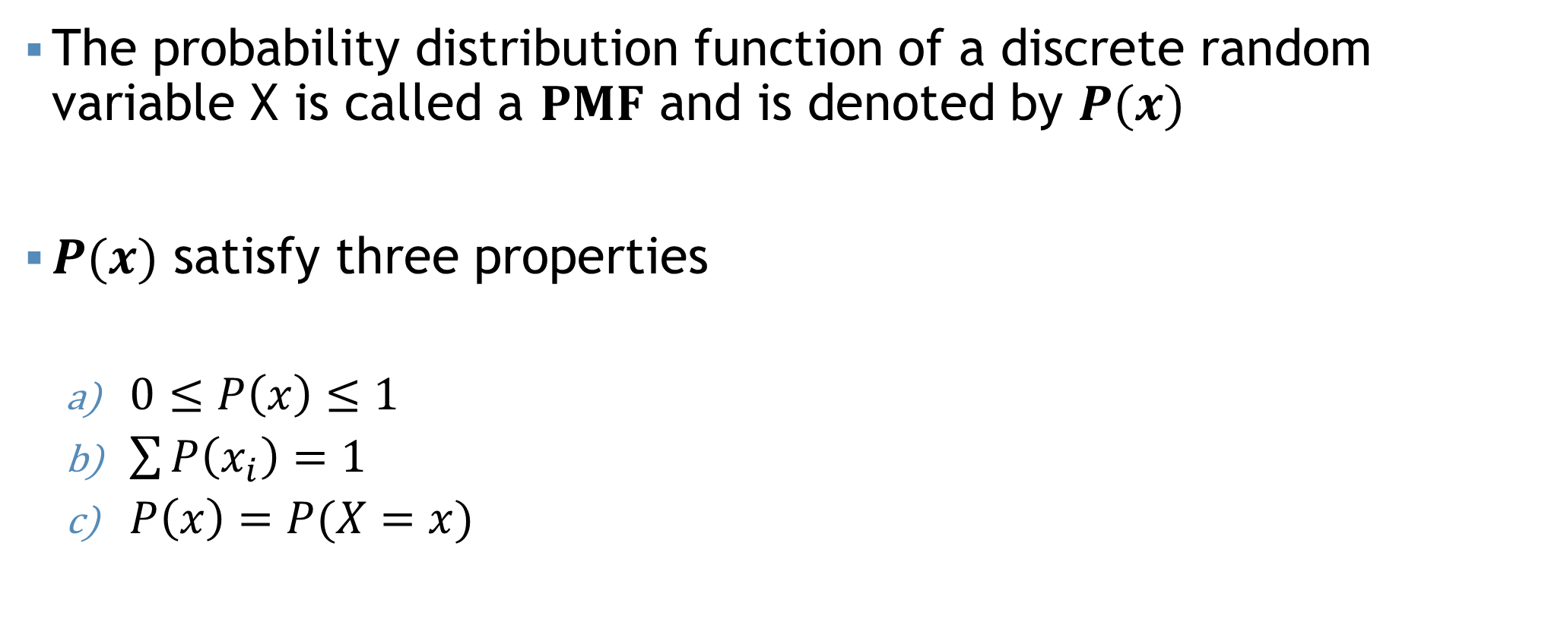
Probability Mass Function (PMF)
The probability distribution function of a discrete random variable X is called a $PMF$ and is denoted by $P(x)$
$P(x)$ satisfy three properties
$0≤P\left(x\right)≤1$
$\sum{P\left(x_{i}\right)=1}$
$P\left(x\right)=P(X=x)$
$$X$$ | 0 | 1 | 2
$$P(x)$$ | 1/4 | 2/4 | 1/4

Slide 21
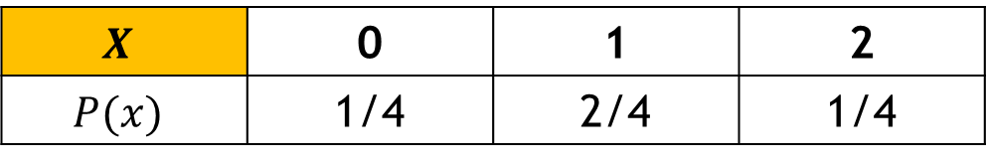
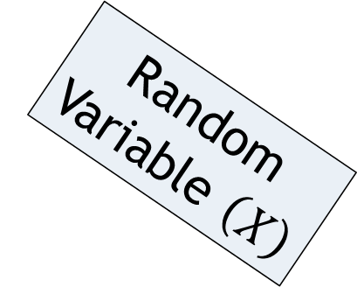
Probability Mass Function (PMF)
The probability distribution function of a discrete random variable X is called a $PMF$ and is denoted by $P(x)$
$P(x)$ satisfy three properties
$0≤P\left(x\right)≤1$
$\sum{P\left(x_{i}\right)=1}$
$P\left(x\right)=P(X=x)$
$$X$$ | 0 | 1 | 2
$$P(x)$$ | 1/4 | 2/4 | 1/4
Random Variable $\left(X\right)$

Slide 22
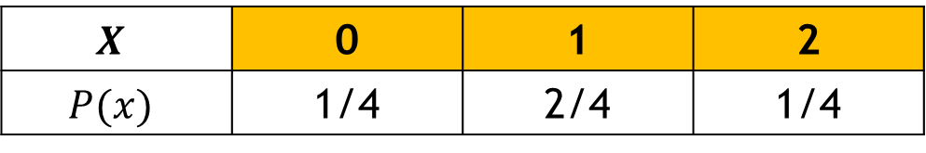


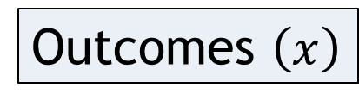
Probability Mass Function (PMF)
The probability distribution function of a discrete random variable X is called a $PMF$ and is denoted by $P(x)$
$P(x)$ satisfy three properties
$0≤P\left(x\right)≤1$
$\sum{P\left(x_{i}\right)=1}$
$P\left(x\right)=P(X=x)$
Outcomes $\left(x\right)$
$$X$$ | 0 | 1 | 2
$$P(x)$$ | 1/4 | 2/4 | 1/4
$$P(2)$$
$$P(X=2)$$

Slide 23
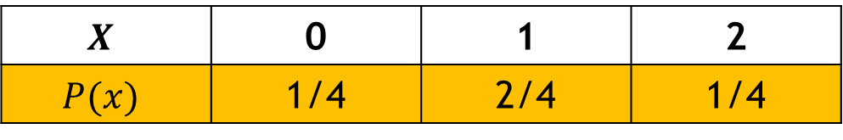
Probability Mass Function (PMF)
The probability distribution function of a discrete random variable X is called a $PMF$ and is denoted by $P(x)$
$P(x)$ satisfy three properties
$0≤P\left(x\right)≤1$
$\sum{P\left(x_{i}\right)=1}$
$P\left(x\right)=P(X=x)$
$$X$$ | 0 | 1 | 2
$$P(x)$$ | 1/4 | 2/4 | 1/4

Slide 24
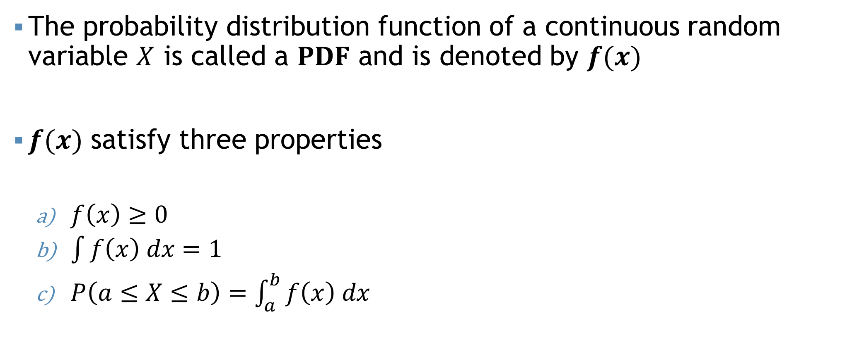
Probability Density Function (PDF)
The probability distribution function of a continuous random variable $X$ is called a $PDF$ and is denoted by $f(x)$
$f(x)$ satisfy three properties
$f\left(x\right)≥0$
$\int{f\left(x\right) dx=1}$
$P\left(a≤X≤b\right)=\int_{a}^{b}{f\left(x\right) dx}$

Slide 25
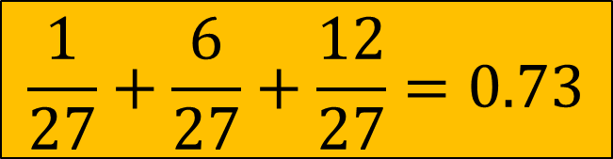


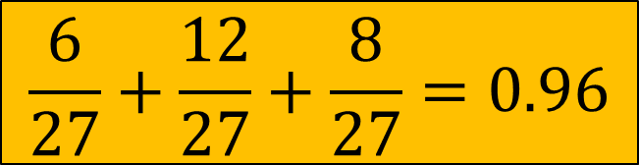
Example
$$X$$ | 0 | 1 | 2 | 3
$$P(x)$$ | 1/27 | 6/27 | 12/27 | 8/27
$$\frac{6}{27}+\frac{12}{27}+\frac{8}{27}=0.96$$
$$P(X≥1)$$
$$P\left(X=1\right)+P\left(X=2\right)+P(X=3)$$
$$\frac{1}{27}+\frac{6}{27}+\frac{12}{27}=0.73$$
$$P(X≤2)$$
$$P\left(X=0\right)+P\left(X=1\right)+P(X=2)$$

Slide 26
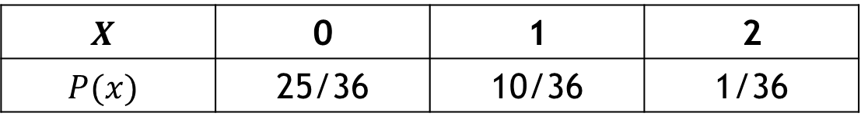
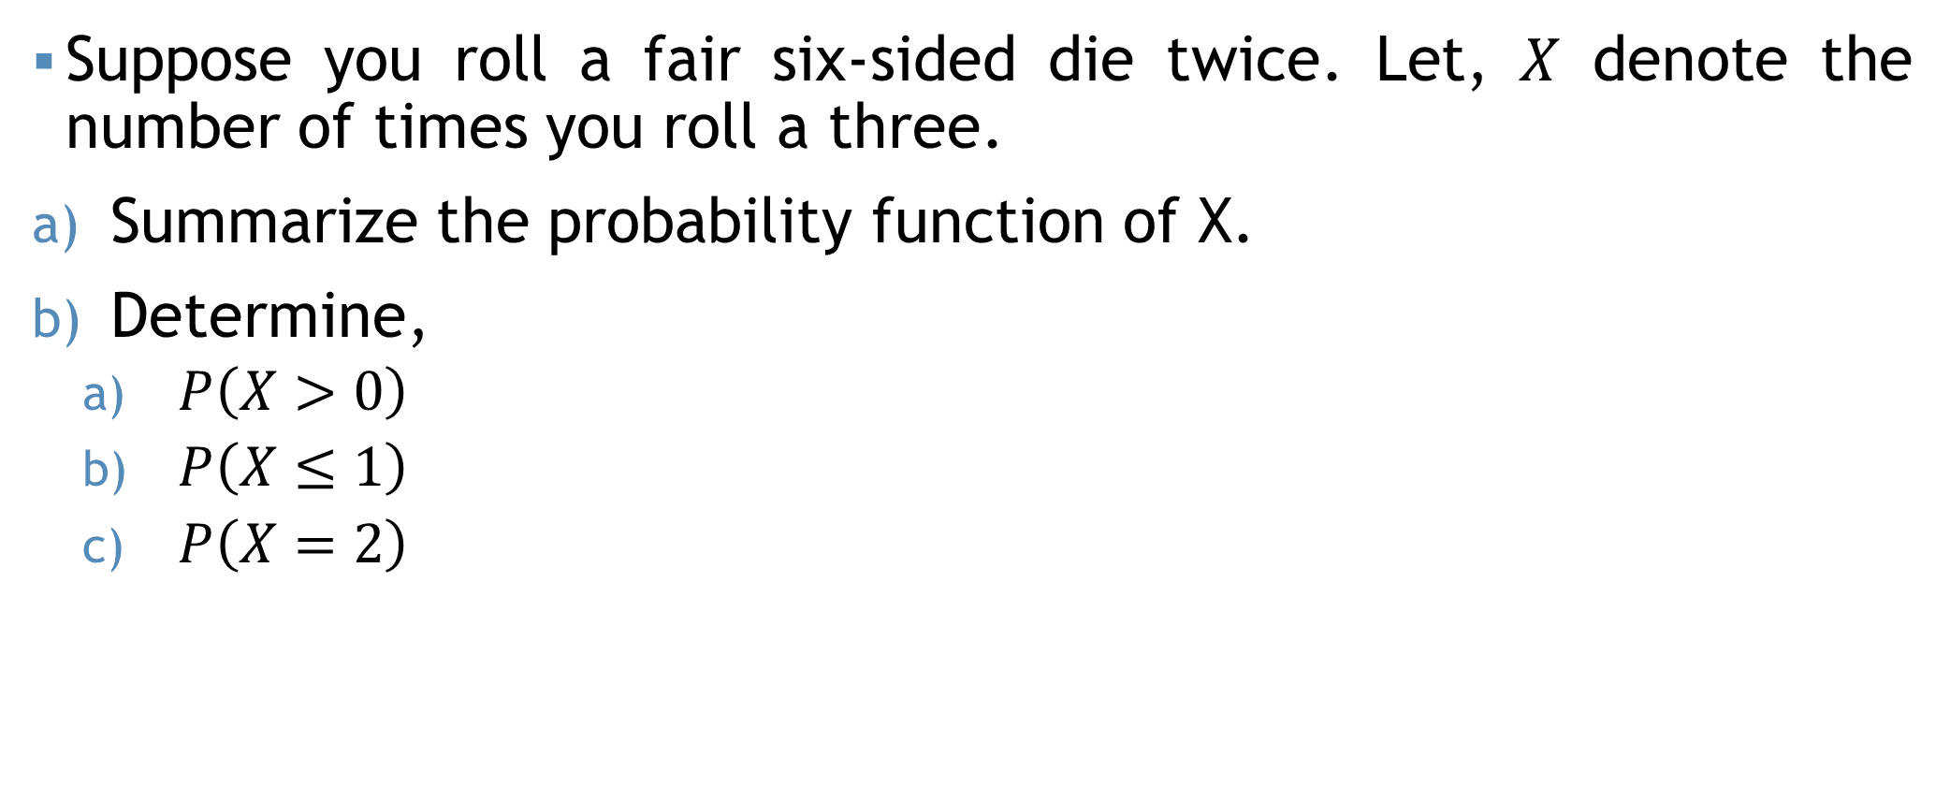
Example
Suppose you roll a fair six-sided die twice. Let, $X$ denote the number of times you roll a three.
Summarize the probability function of X.
Determine,
$P\left(X>0\right)$
$P\left(X≤1\right)$
$P\left(X=2\right)$
Ans:11/36
$$X$$ | 0 | 1 | 2
$$P(x)$$ | 25/36 | 10/36 | 1/36
Ans:35/36
Ans:1/36

Slide 27
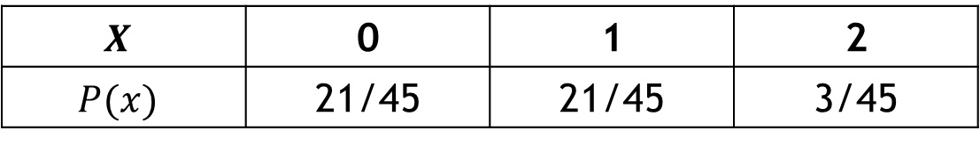
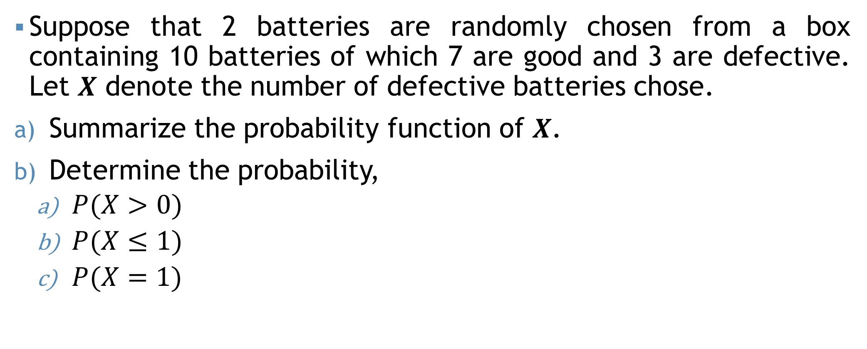
Example
Suppose that 2 batteries are randomly chosen from a box containing 10 batteries of which 7 are good and 3 are defective. Let $X$ denote the number of defective batteries chose.
Summarize the probability function of $X$.
Determine the probability,
$P(X>0)$
$P(X≤1)$
$P(X=1)$
Ans:24/45
$$X$$ | 0 | 1 | 2
$$P(x)$$ | 21/45 | 21/45 | 3/45
Ans:42/45
Ans:21/45

Slide 28
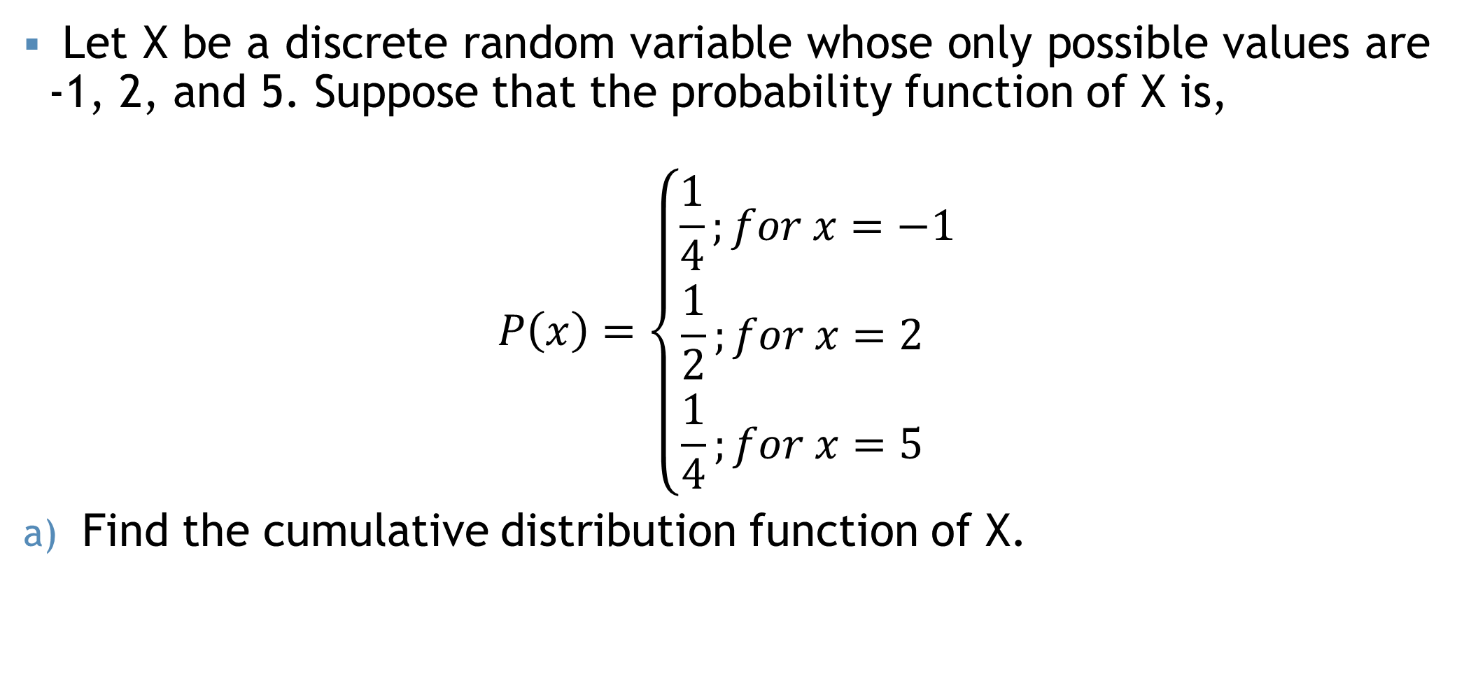
Example
Let X be a discrete random variable whose only possible values are -1, 2, and 5. Suppose that the probability function of X is,
$$P\left(x\right)=\left\{\begin{aligned}\frac{1}{4};for x=−1 \\ \frac{1}{2};for x=2 \\ \frac{1}{4};for x=5 \end{aligned}\right.$$
Find the cumulative distribution function of X.

Slide 29




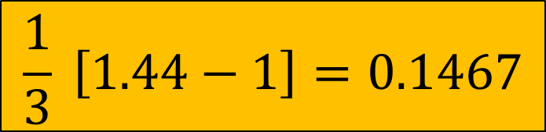




Example
$$P\left(X>1.2\right)=???$$
$$P\left(1.2≤X≤1.6\right)=???$$
$$P\left(X=1.5\right)=???$$
$$P\left(X>3.5\right)=???$$
Let, $X$ be a random variable with probability function,
$$f\left(x\right)=\left\{\begin{aligned}\frac{2x}{3}; if 1≤x≤2 \\ 0, Otherwise\end{aligned}\right.$$
$$\int_{1}^{1.2}{\frac{2x}{3} dx}$$
$$\frac{2}{3}{\left[\frac{x^{2}}{2}\right]}_{1}^{1.2}$$
$$\frac{1}{3} \left[1.44−1\right]=0.1467$$
$$P(X≤1.2)$$

Slide 30
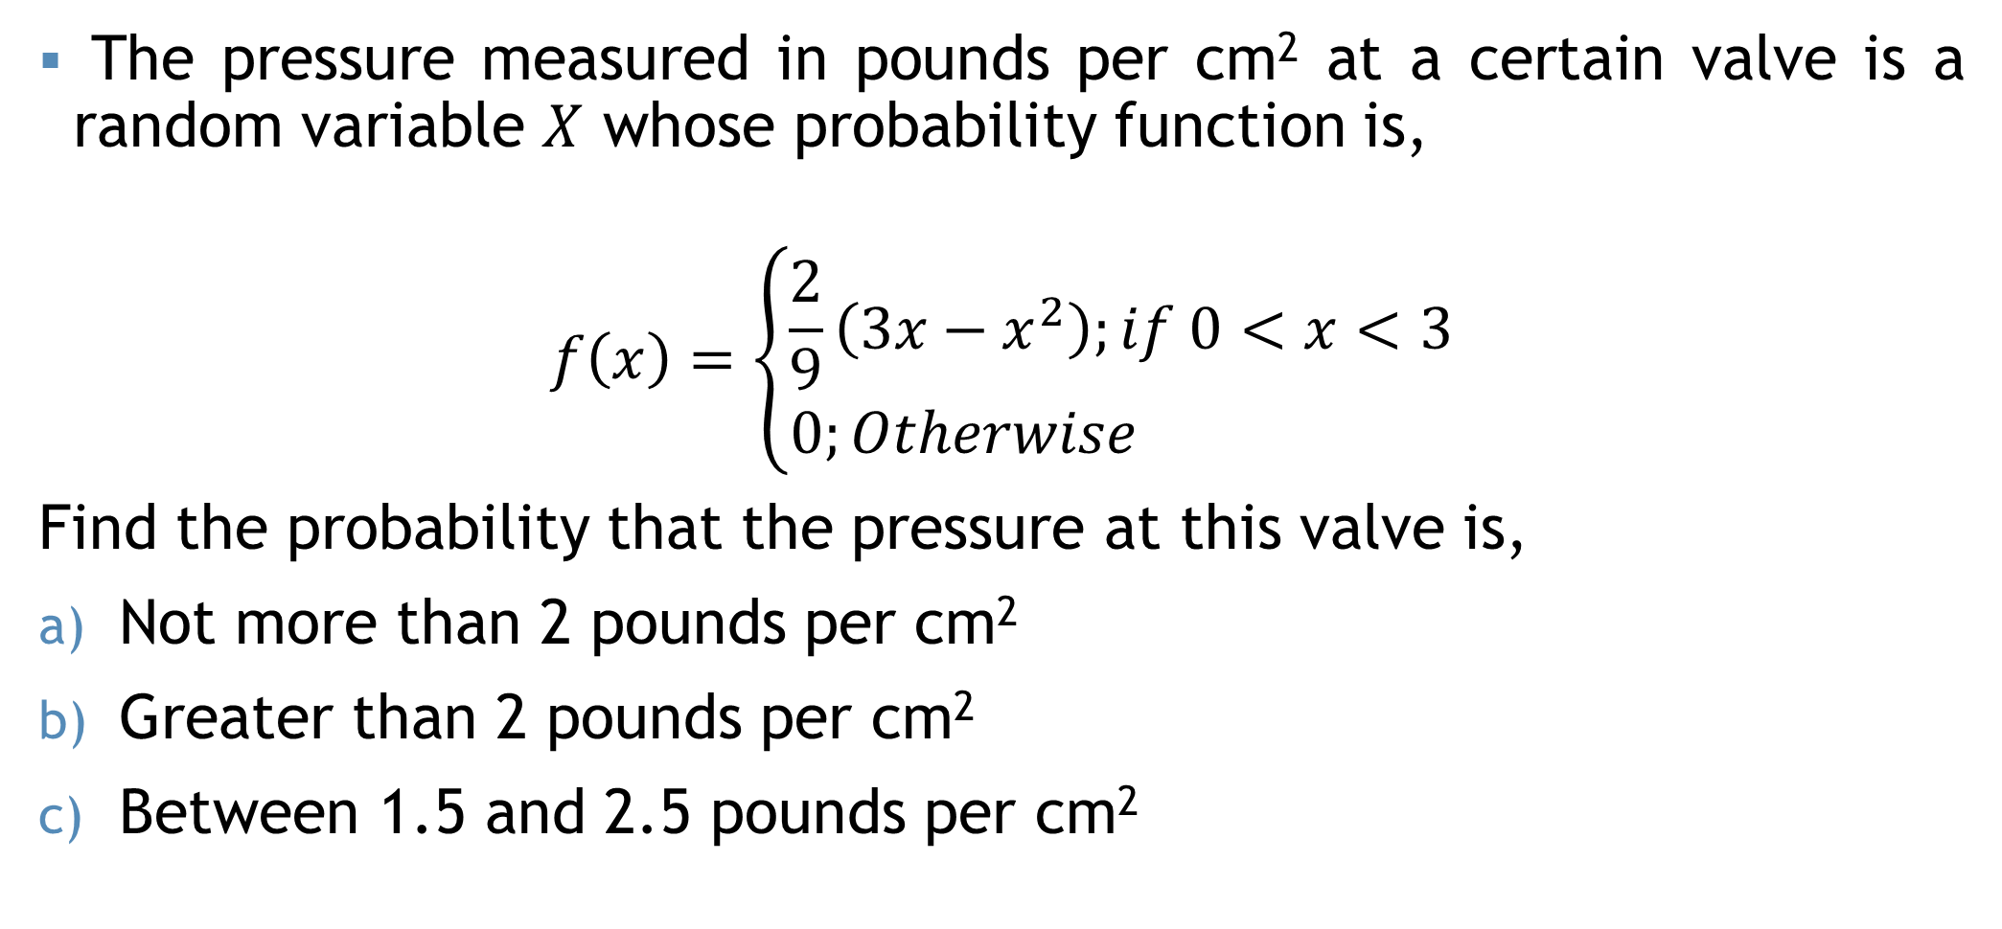
Example
The pressure measured in pounds per cm² at a certain valve is a random variable $X$ whose probability function is,
$$f\left(x\right)=\left\{\begin{aligned}\frac{2}{9}\left(3x−x^{2}\right);if 0<x<3 \\ 0;Otherwise \end{aligned}\right.$$
Find the probability that the pressure at this valve is,
Not more than 2 pounds per cm²
Greater than 2 pounds per cm²
Between 1.5 and 2.5 pounds per cm²
Ans:0.7402
Ans:0.2593
Ans:4259

Slide 31
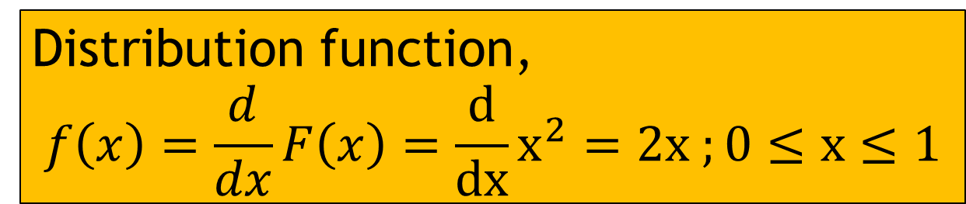
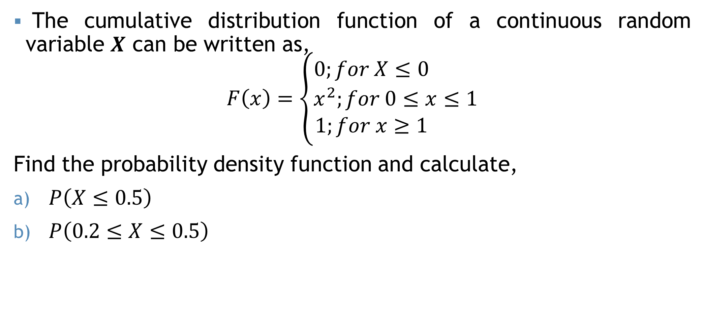
Example
The cumulative distribution function of a continuous random variable $X$ can be written as,
$$F\left(x\right)=\left\{\begin{aligned}0;for X≤0 \\ x^{2};for 0≤x≤1 \\ 1;for x≥1 \end{aligned}\right.$$
Find the probability density function and calculate,
$P\left(X≤0.5\right)$
$P\left(0.2≤X≤0.5\right)$
Ans:0.25
Ans:0.21
Distribution function,
$$f\left(x\right)=\frac{d}{dx}F\left(x\right)=\frac{d}{dx}x^{2}=2x ;0≤x≤1$$

Slide 32
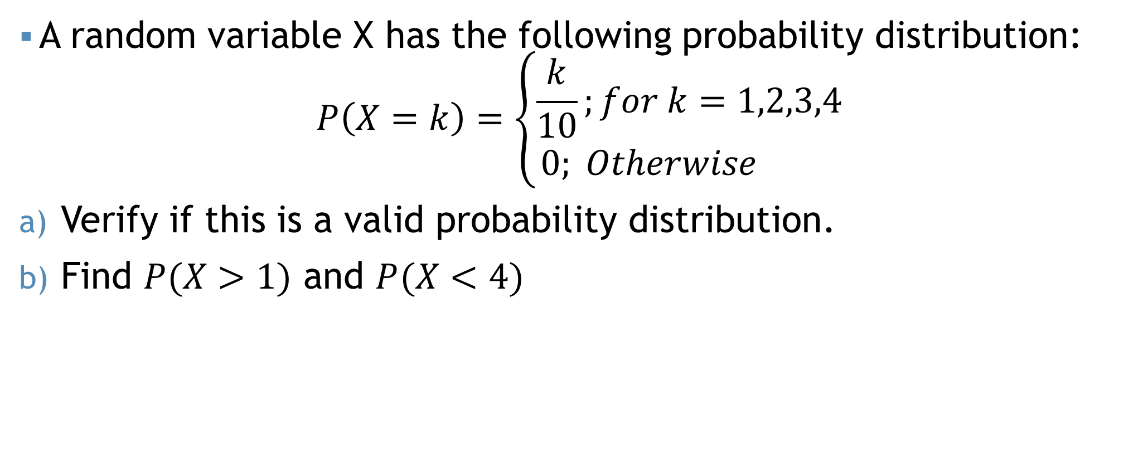
Self Practice !!!
A random variable X has the following probability distribution:
$$P\left(X=k\right)=\left\{\begin{aligned}\frac{k}{10};for k=1,2,3,4 \\ 0; Otherwise \end{aligned}\right.$$
Verify if this is a valid probability distribution.
Find $P(X>1)$ and $P(X<4)$

Slide 33
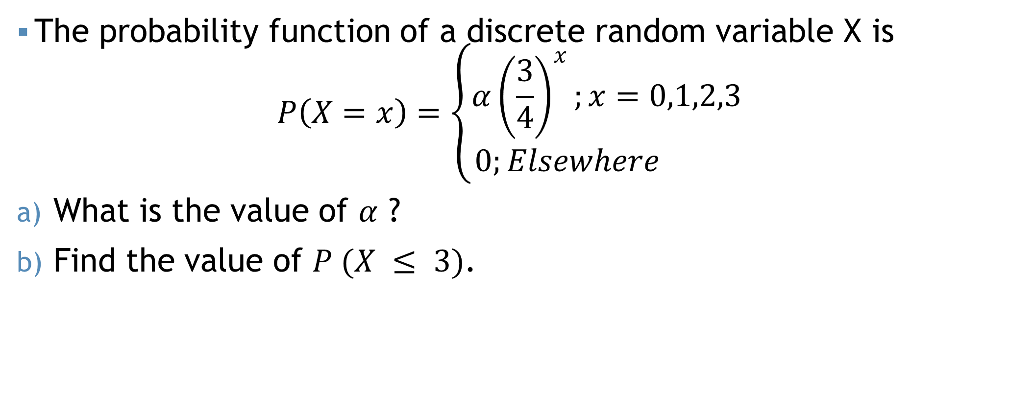
Self Practice !!!
The probability function of a discrete random variable X is
$$P\left(X=x\right)=\left\{\begin{aligned}α{\left(\frac{3}{4}\right)}^{x};x=0,1,2,3 \\ 0;Elsewhere \end{aligned}\right.$$
What is the value of $α$ ?
Find the value of $P (X ≤ 3)$.

Slide 34
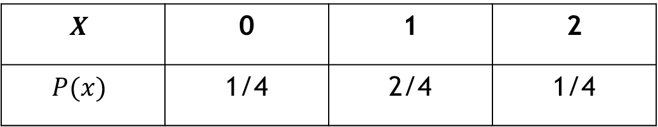


Mathematical Expectation
$$E(X)$$
The probability of $X$ contains all of the probabilistic information about $X$.
The whole distribution usually too cumbersome for presentation
Summary measure (Mean, Variance, Median) may be useful
$$X$$ | 0 | 1 | 2
$$P(x)$$ | 1/4 | 2/4 | 1/4

Slide 35
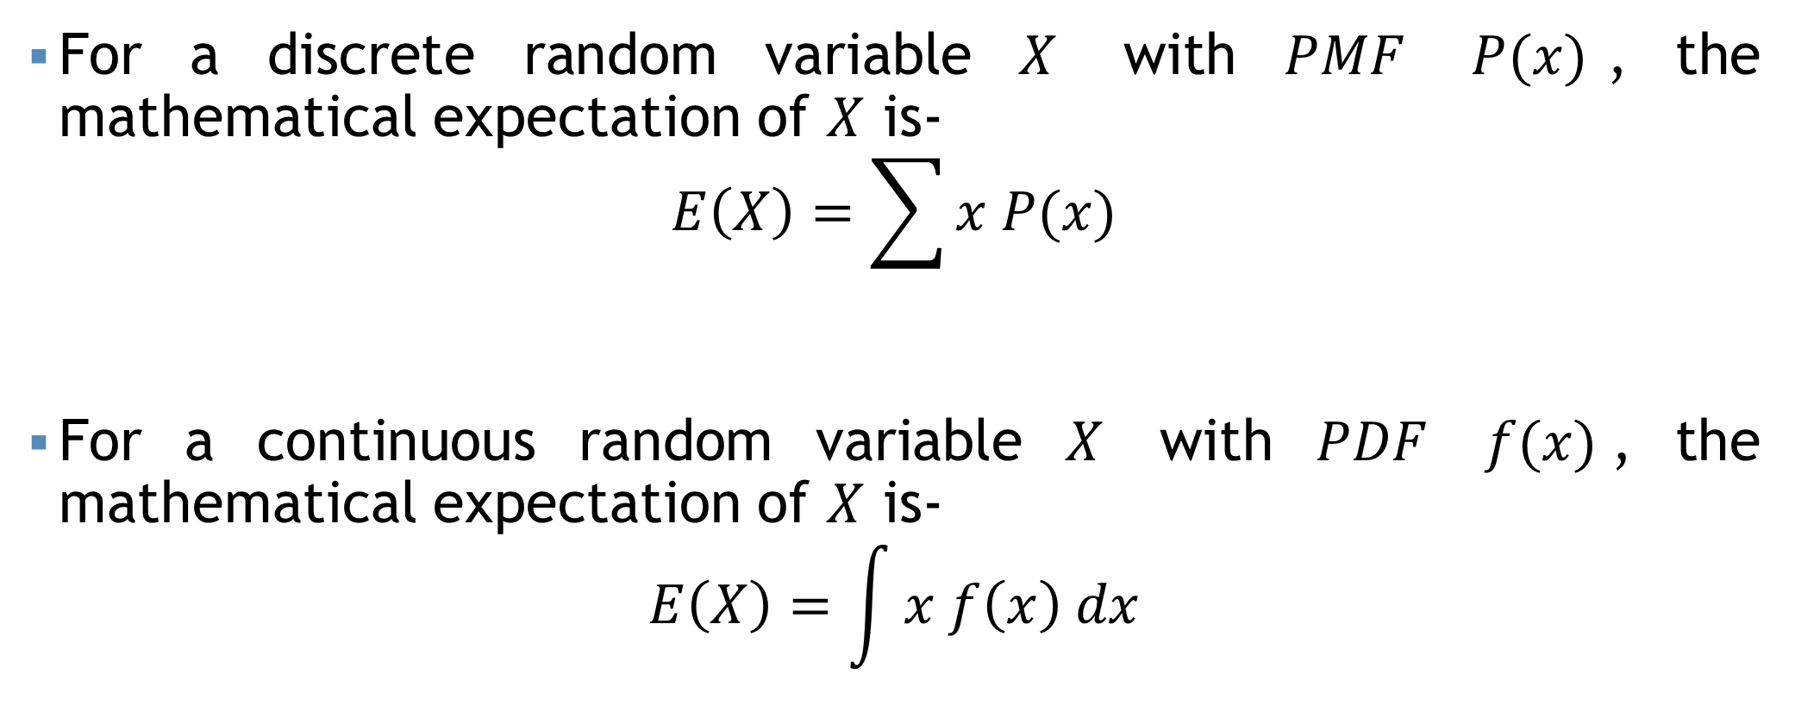
Mathematical Expectation
For a discrete random variable $X$ with $PMF$ $P(x)$, the mathematical expectation of $X$ is-
$$E\left(X\right)=\sum{x P(x)}$$
For a continuous random variable $X$ with $PDF$ $f(x)$, the mathematical expectation of $X$ is-
$$E\left(X\right)=\int{x f\left(x\right) dx}$$

Slide 36
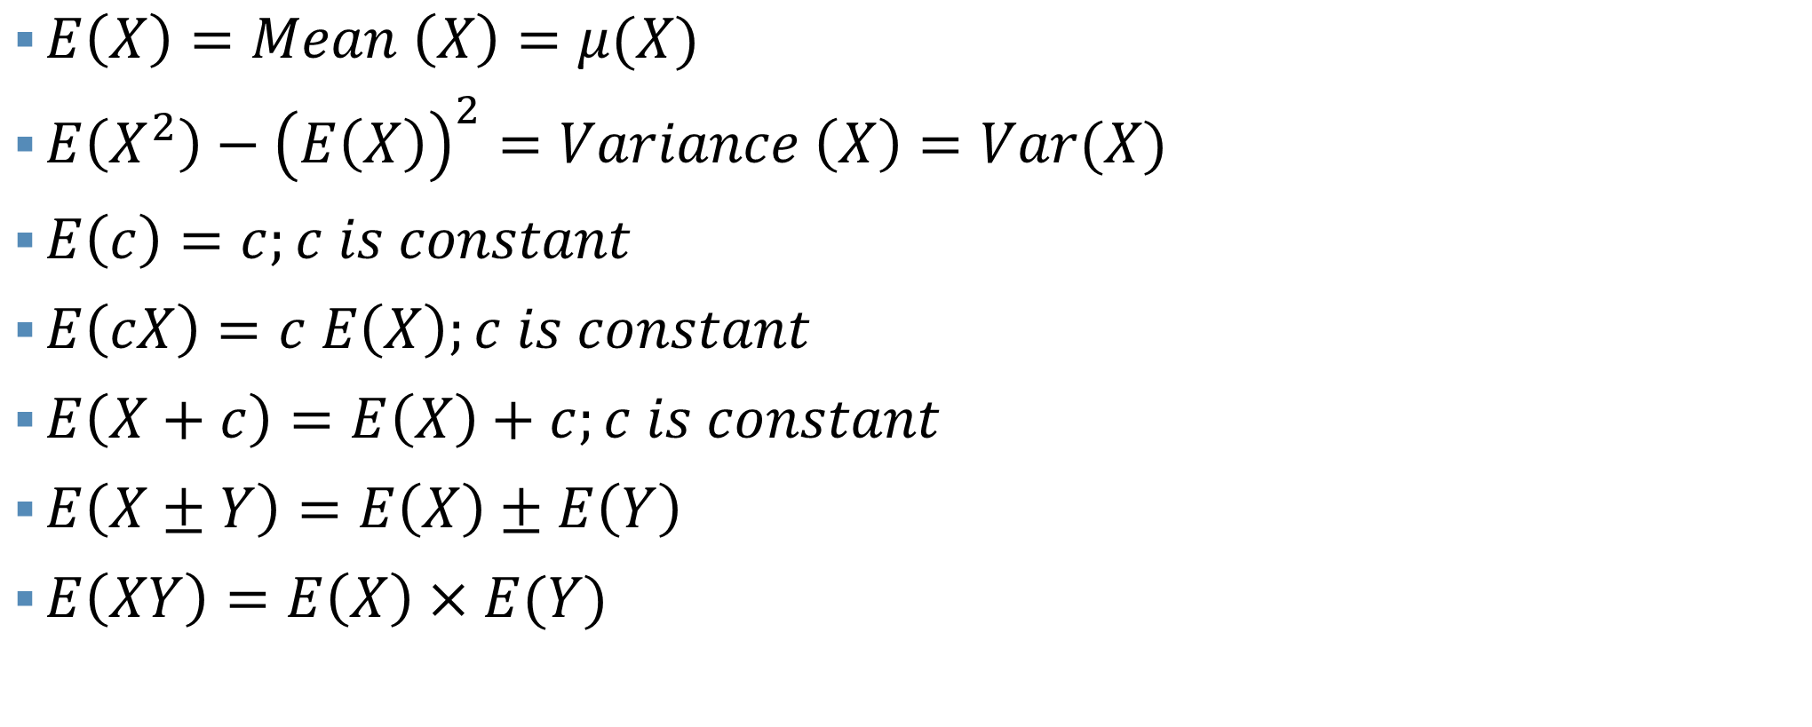
Properties
$E\left(X\right)=Mean \left(X\right)=μ(X)$
$E\left(X^{2}\right)−{\left(E\left(X\right)\right)}^{2}=Variance \left(X\right)=Var(X)$
$E\left(c\right)=c;c is constant$
$E\left(cX\right)=c E\left(X\right);c is constant$
$E\left(X+c\right)=E\left(X\right)+c;c is constant$
$E\left(X±Y\right)=E\left(X\right)±E\left(Y\right)$
$E\left(XY\right)=E\left(X\right)×E(Y)$

Slide 37

Properties
$Var\left(c\right)=0;c is constant$
$Var\left(cX\right)=c^{2} Var(X)$
$Var\left(X+c\right)=Var\left(X\right)+Var\left(c\right)=Var\left(X\right)$
$Var\left(X±Y\right)=Var(X)±Var(Y)$

Slide 38
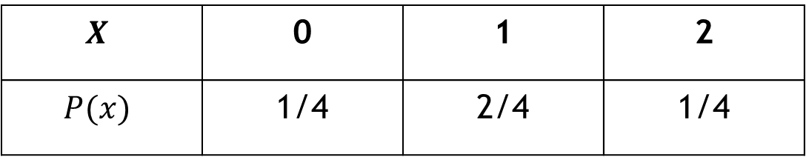

Example
$$X$$ | 0 | 1 | 2
$$P(x)$$ | 1/4 | 2/4 | 1/4
Find the mean and variance of
$$Mean, E\left(X\right)=\sum{x P(x)}=\left(0×\frac{1}{4}\right)+\left(1×\frac{2}{4}\right)+\left(2×\frac{1}{4}\right)=1$$
$$Var\left(X\right)=E\left(X^{2}\right)−{\left(E\left(X\right)\right)}^{2}= ???$$

Slide 39
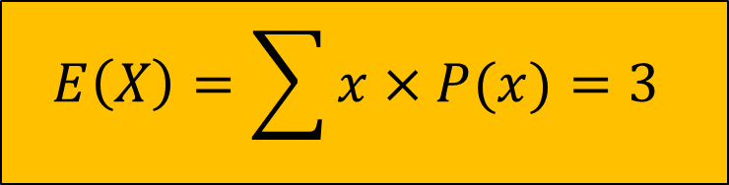
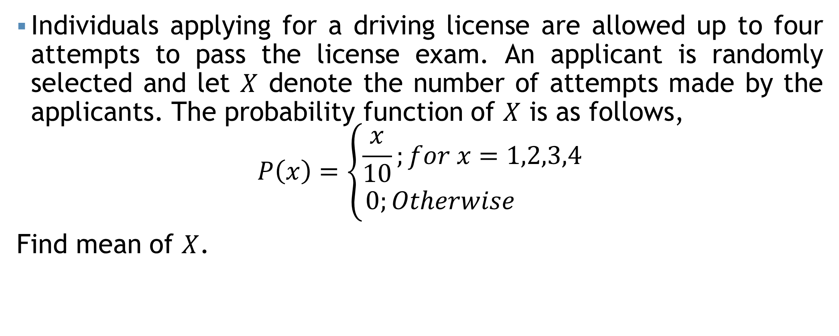
Example
Individuals applying for a driving license are allowed up to four attempts to pass the license exam. An applicant is randomly selected and let $X$ denote the number of attempts made by the applicants. The probability function of $X$ is as follows,
$$P\left(x\right)=\left\{\begin{aligned}\frac{x}{10};for x=1,2,3,4 \\ 0;Otherwise \end{aligned}\right.$$
Find mean of $X$.
$$E\left(X\right)=\sum{x×P(x)}=3$$
The mean number of attempts required to pass the license exam is 3

Slide 40


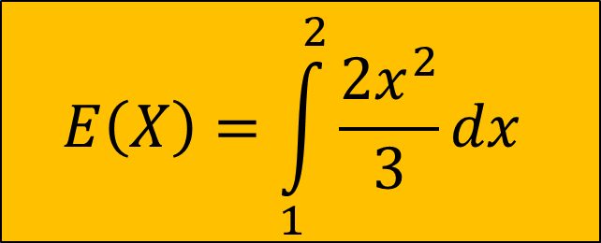
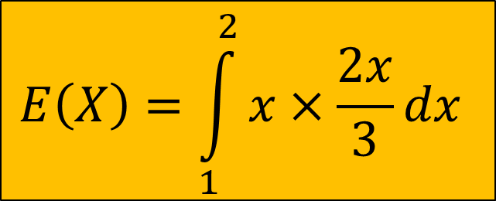
Example
Let, $X$ be a continuous random variable with pdf,
$$f\left(x\right)=\left\{\begin{aligned}\frac{2x}{3}; if 1≤x≤2 \\ 0, Otherwise\end{aligned}\right.$$
??????
$$E\left(X\right)=\int_{1}^{2}{x f\left(x\right)dx}$$
$$E\left(X\right)=\int_{1}^{2}{x×\frac{2x}{3}dx}$$
$$E\left(X\right)=\int_{1}^{2}{\frac{2x^{2}}{3}dx}$$
Mean

Slide 41
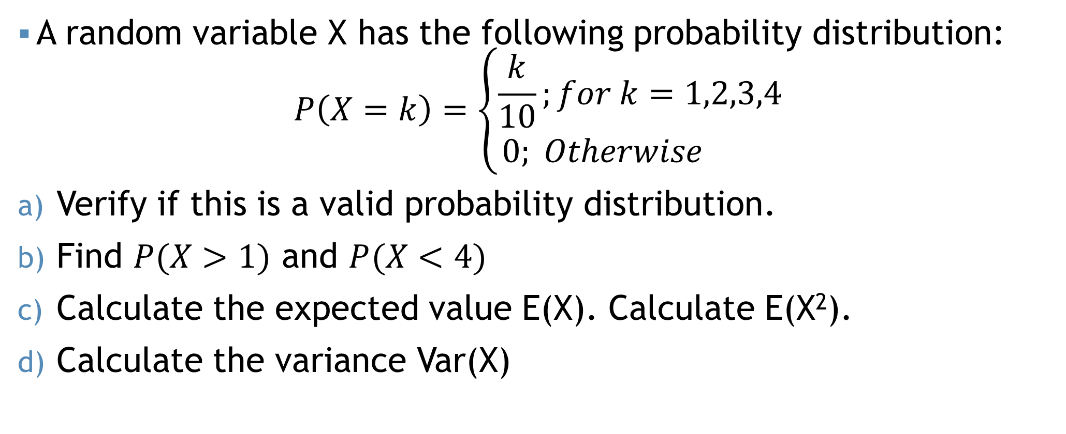
Self Practice !!!
A random variable X has the following probability distribution:
$$P\left(X=k\right)=\left\{\begin{aligned}\frac{k}{10};for k=1,2,3,4 \\ 0; Otherwise \end{aligned}\right.$$
Verify if this is a valid probability distribution.
Find $P(X>1)$ and $P(X<4)$
Calculate the expected value E(X). Calculate E(X²).
Calculate the variance Var(X)

Slide 42
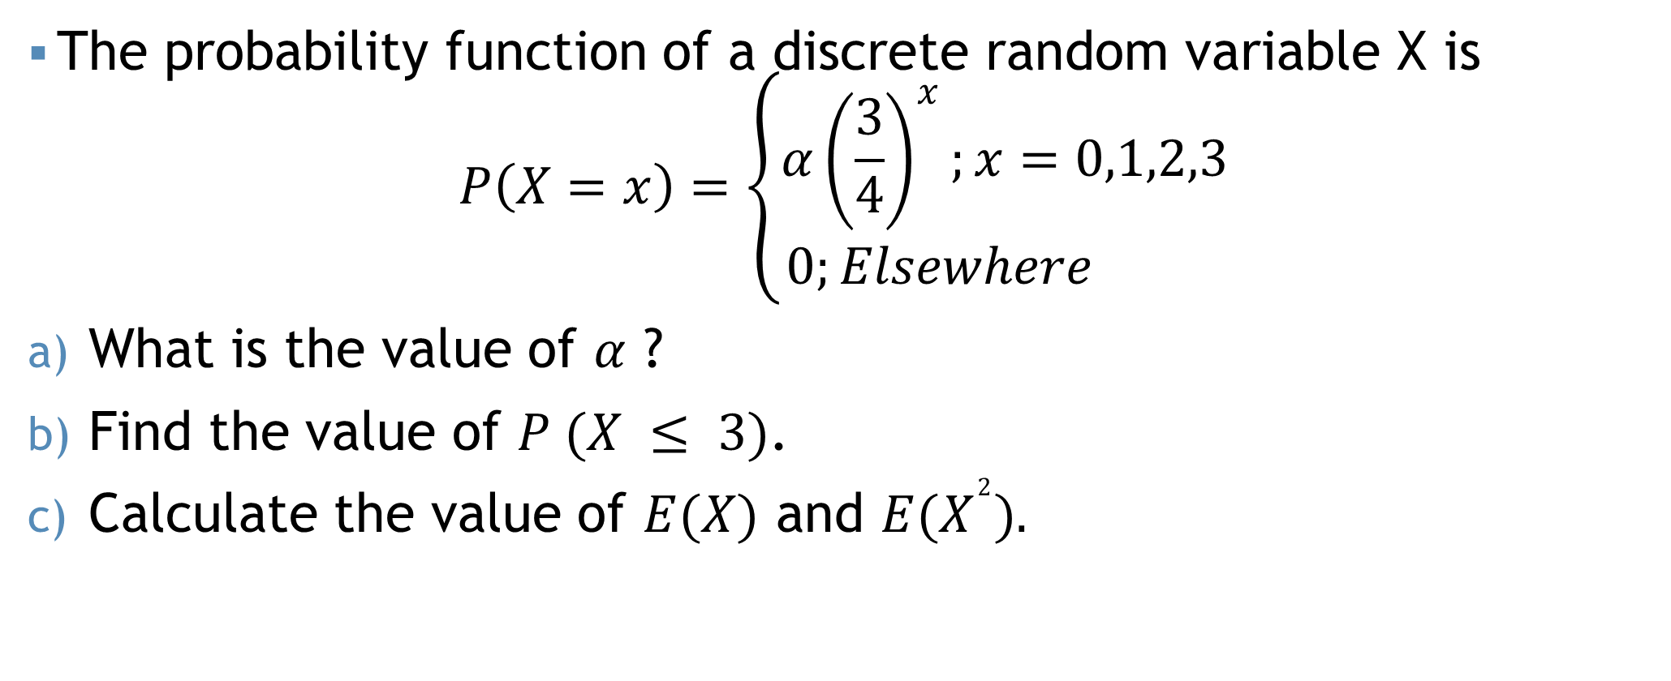
Self Practice !!!
The probability function of a discrete random variable X is
$$P\left(X=x\right)=\left\{\begin{aligned}α{\left(\frac{3}{4}\right)}^{x};x=0,1,2,3 \\ 0;Elsewhere \end{aligned}\right.$$
What is the value of $α$ ?
Find the value of $P (X ≤ 3)$.
Calculate the value of $E(X)$ and $E(X^{2}).$

Slide 43
Mathematical exercise
To access additional mathematical problems, please refer to the PDF lecture notes.

Slide 44
Thank You

